Slide 1
Infrared
Encoder and Barcode
With Pico

Slide 2
Tracking Velocity with Encoder

Slide 3
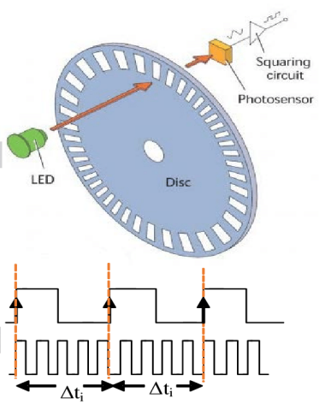
Wheel Encoder Interrupt
Count the number of notches passed in a second and multiply the number with the distance per notch.
The distance per notch calculated by:
circumference of wheel / number of notches on encoder
Wheel encoder interrupts each time edge fall is detected. The count the number of notches passed

Slide 4
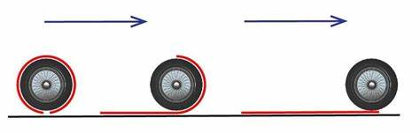
Timer Interrupt
A timer is then set to trigger an interrupt every second where the distance is calculated and the counter will be reset.
The distance travelled within the second is calculated by:
No. of notches * distance per notch
This runs continuously giving the speed every second

Slide 5
Barcode-39 Scanner

Slide 6
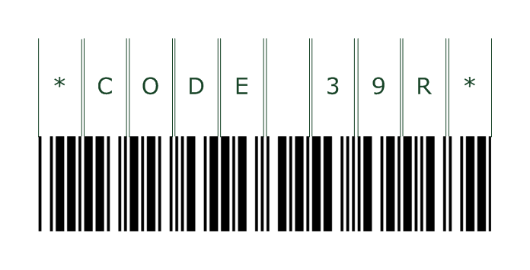
Code 39
Up to 43 characters including numbers, letters and some symbols can be included in the barcode.
There is a start and end character ( * ) and the data is in the middle.
There is a certain bar pattern for each character; which is made up of 9 bars and spaces.

Slide 7
Timer Interrupt
Every 10ms, we check the value being returned by the infrared sensor.
Add 1 to black or white counter depending on the voltage.

Slide 8

Filtering with Threshold
Compare the value of the counter to determine whether its thin or thick
100001001
Threshold is determined from the first thin black bar of the * character
‘1’ being thick and ‘0’ being thin

Slide 9
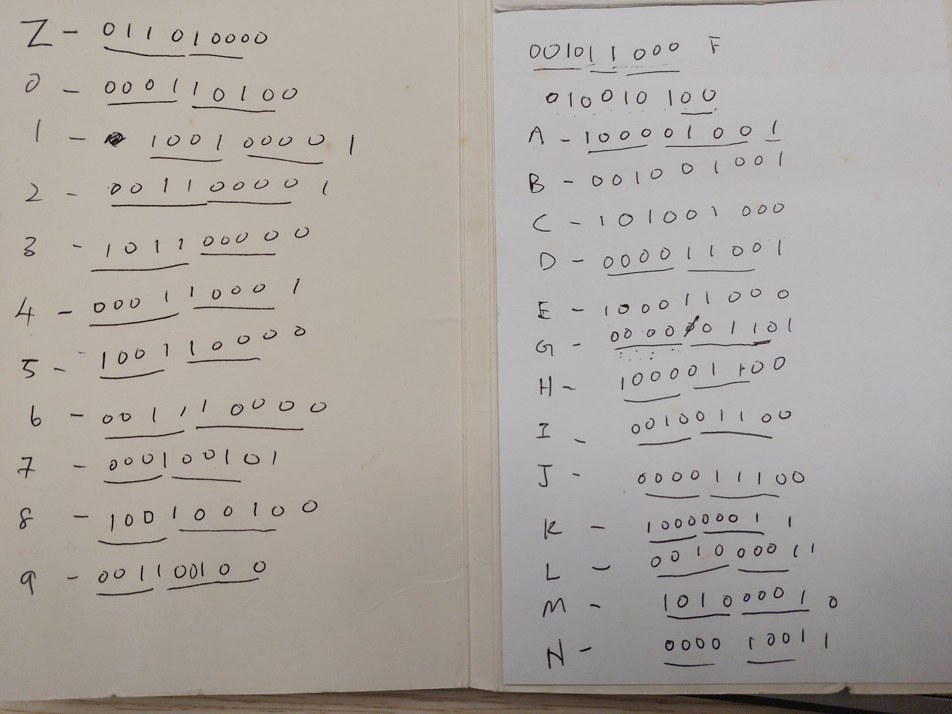
Dictionary
bitString = “100001001”
String of bits gets compared with dictionary which holds all the manual calculated bit string for each character.
A

